Slide 1
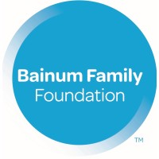
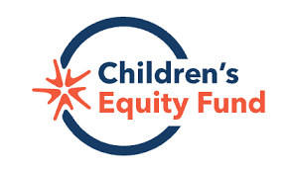

The Power of the Pause: Shared Learning for Adaptive Philanthropy
June 1, 2026

Slide 2

Sister Organizations
Shared vision, complementary missions
Bainum Family Foundation
Children’s Equity Fund
Vision
A society where all children thrive.
Mission
We work alongside communities experiencing racial and economic disparities to create lasting systems change for the well-being of children and families.
Vision
A society where all children and families thrive.
Mission
We champion comprehensive policy changes at the federal, state and local levels to create lasting systems change that improves the well-being of children and families.
Notes:
The Bainum family foundation was founded in 1968 and has historically focused on funding direct service efforts to support children and families. But as time went on, we began to see a deeper truth. While direct service is essential, it alone cannot address the root causes of the challenges our communities face. In 2020, we launched a new strategic planning process that built on the foundation of our previous plan. It reaffirmed our commitment to direct service, but also expanded our vision to include systems change, recognizing that lasting impact requires shifting the structures and policies that shape people’s lives.
Around that same time, we also began to confront a structural limitation: operating as a private foundation restricted the tools we had to advance our vision. So, we asked ourselves and the communities we served, “What more can we do?” and “What would it look like to expand our reach?” “What if we could unlock new avenues for advocacy and civic engagement?”
That’s when the idea of an affiliated organization took shape. And as you may have guessed from the title of this session, in 2020 the 501(c)(4), now known as the Children’s Equity Fund, launched. This new entity has the flexibility to engage in policy and advocacy work that complements the foundation’s efforts and brings all of us closer to realizing our vision of a society where all children and families thrive.

Slide 3

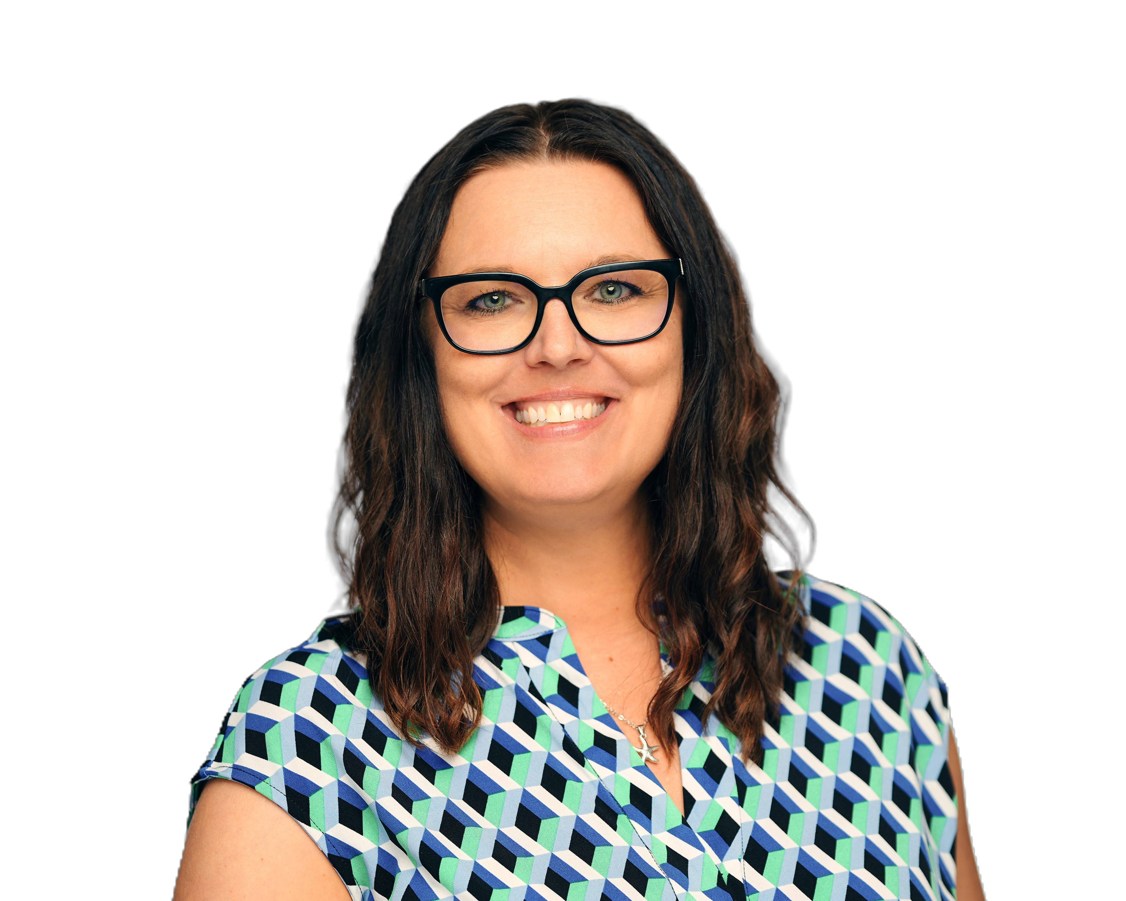
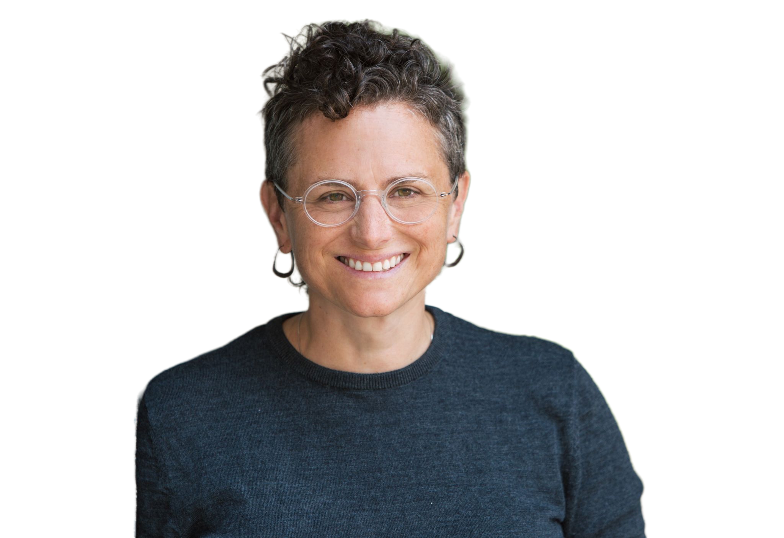
Presenters
Dr. Amy Erickson Soper
Director, Org. Learning & Impact
Bainum Family Foundation
Children’s Equity Fund
Julia McKay
Senior Manager, Healthy Democracy
Children’s Equity Fund
Gabriela Fitz
Independent Consultant
Think Twice

Slide 4
Session Outcomes
Explore why pausing for shared learning matters for adaptive philanthropy
Experience reflection and sensemaking through the What?/So What?/Now What? Model
Engage in a Story Harvest as a participatory
sensemaking practice
Reflect on how shared learning shows up in your work and where the practice could be strengthened
Leave with practical ideas and tools that can be
applied across our different contexts

Slide 5
Why Internal Learning Matters
Notes:
Philanthropic sector doesn’t have accountability structures.
Building intentional, internal shared learning practices is one of the ways we have been working to ensure alignment and accountability in who we say we are, how we work together, and the impact we’re trying to have.
We started with building our internal collective learning muscles before applying these approaches externally with grantees and other partners.

Slide 6
Aligning Learning, Performance, and Impact
Organization
Strengthens accountability to our core values, strategic approaches, and commitments (internally and externally)
Builds shared understanding and alignment across roles and teams
Makes individual and team knowledge visible, shared, and usable across the organization
Team
Individual
Notes:
Amy
Learning together helps us live our values, not just name them.
Accountability is individual and collective
Shared reflection builds understanding across roles, levels, and teams; otherwise learning stays siloed and disconnected.
Collective reflection ensures individual and team contextual/historical knowledge isn’t lost. It becomes visible and usable across the organization.
Alignment isn’t automatic; learning together helped make it visible and create coherence
Collective reflection helps connects individual work to team and organizational outcomes
Through shared learning, it became clearer how individual work contributes to collective outcomes — and how organizational priorities, in turn, shape team and individual work.

Slide 7
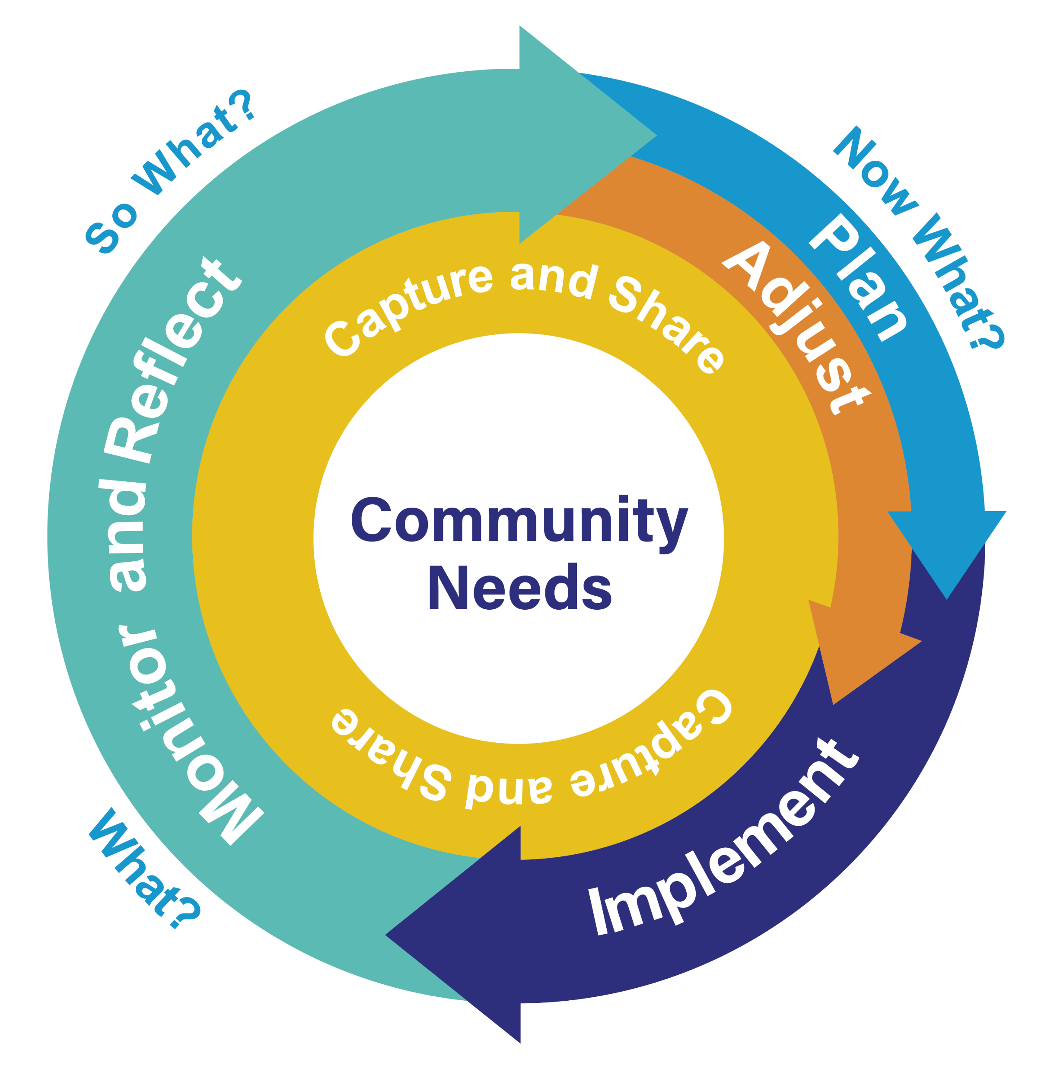
Reflecting With Purpose
Supports shared reflection and collective sensemaking amid complexity and change
Learning informs and drives action
Supports adaptive, responsive strategic decision‑making
Notes:
Amy
We don’t see learning as separate from strategy — it’s central to it.
The work we do is complex and continually evolving in response to community needs.
We developed a learning cycle to give us a shared structure for thinking about how learning informs action.
Pausing for collective reflection and out loud sensemaking helps us adapt responsibly and strategically, so decisions we make stay grounded in community needs, not just our internal perspectives.

Slide 8
We’re aiming to create a virtuous cycle of aligning, acting, and learning that results in better ideas, strategies, and ways of working that increase our impact.
adrienne maree brown, Emergent Strategy, p. 175
Notes:
Learning can’t happen if we don’t stop to notice and reflect. And this quote by adrienne maree brown captures why that pause is so essential — especially in complex, changing work.

Slide 9
Designing Shared Learning Practices
All-Staff Learning Sessions
Notes:
There are many ways we live out our learning cycle.
Today we want to specifically focus on our all-staff learning sessions, which began in December 2022.
We realized pretty quickly that shared learning wasn’t going to happen unless we intentionally created space to pause, reflect, and make meaning together.
At both the Bainum Family Foundation and the Children’s Equity Fund, we’ve been using the same internal learning practice, adapted to the rhythms and content needs of each organization.
Our approach has evolved over time, but there were some essential moves we made early on that really mattered.

Slide 10
What It Takes
Establishing buy-in and expectations
Sustained Buy-in
Ongoing buy‑in from senior leadership
Active Participation
Participation expected, not optional
Dedicated Time
Protected, scheduled time for shared learning
Notes:
Gained buy in and established expectations
Senior leader buy‑in signaled importance and that shared learning was a priority (buy-in to the idea, buy-in when adapting process)
Participation was expected, not optional. (Learning is a part of the job and our culture.)
Learning had to be protected; if wasn’t scheduled it is easy to get caught up in the urgency of day-to-day work.

Slide 11
Designing for
Learning
Consistent Cadence
Building a routine for reflection and shared learning
Pragmatic
and Applied
Focusing on real work, turning insights into action
Psychological Safety
Creating a brave space that supports honest reflection
Approachable Sensemaking
Utilizing “What?/So What?/Now What?” model
Intentional Grouping
Bringing together diverse roles and perspectives

Slide 12
What? So What? Now What? Model
What?
Experiences
and Observations
Notes:
What? So What? Now What? model gives us a shared structure and language for reflecting together.
Connects experience → meaning → action: It helps us move from what happened, to why it matters, to what we should continue or differently.
Supports collective sensemaking, not just individual reflection
Reflection is tied to action, not just insight
What adjustments should we make based on our learnings?
What should we start, stop, continue doing?
How this was adapted for mid-year planning, annual planning, learning agenda
We have been able to apply this sensemaking model in a variety of ways at our Learning Sessions to support a variety of strategy and planning cycle conversations (e.g., annual goal planning, mid-year progress check-ins, exploring our learning agenda).
Questions and protocols are chosen to fit the kind of conversation the work requires.
What’s important here is that this adaptability didn’t just happen automatically. Over time, we were very intentional about how we designed and used protocols. That consistency helped people become more comfortable engaging in shared reflection—and eventually in naming tensions and navigating harder conversations together.
So while the questions and protocols change based on the work, the repeated practice of reflecting together is what built the learning muscle that made this model effective.
Once we had a shared structure for reflection, we needed ways to ground it in real work otherwise learning stays abstract or disconnected from day‑to‑day decisions
Shared learning agenda – Keeps our learning focused on questions that matter most to mission and strategy
Shared learning questions
Help us reflect on progress toward annual objectives
Surface what’s working, what’s getting in the way, and the tensions we’re navigating
Shared knowledge base & protocols
Make learning visible and accessible across roles and teams
Protocols create enough structure to support brave, inclusive conversations

Slide 13
What? So What? Now What? Model
What?
So What?
Experiences
and Observations
Meaning
and Insight

Slide 14
What? So What? Now What? Model
What?
So What?
Now What?
Action
(stay the course
or adjust)
Experiences
and Observations
Meaning
and Insight

Slide 15
What? So What? Now What? Model
What?
So What?
Now What?
Action
(stay the course
or adjust)
Experiences
and Observations
Meaning
and Insight
Adaptable by Design: Questions and Protocols Selected to Fit the Conversation

Slide 16
Shared Learning in Practice: Story Harvest
Notes:
One protocol that’s been especially meaningful in building our internal shared learning muscle is the Story Harvest. Gabi introduced this to us early on in our journey.
Using this protocol over time increased trust and vulnerability among our team. When we first began, many stories were about successes, yet as more stories of navigating challenges or tensions were introduced shared challenges and tensions alongside successes and realized they weren’t alone in navigating the complexity of the work.

Slide 17
Starting with Stories (instead of lessons)
Lived experience
Grounding in practice
Targeted listening
Shared Learning
Shared meaning
making
Witnessing
Notes:
Methodology based on Art of Hosting with some Liberated Structures mixed in
Stories hold more than their tellers realize
Supports different ways of knowing; recognizing and communicating what we know

Slide 18
A Story We All Share
What has it looked like to
shift our relationship with grantee/partners?
A story about
something you
are proud of
A story about
something you would have liked to go differently
Notes:
There is a conversation that THIS group of people can have
For today, since we all work in different organizations, this is the proposed, shared frame … with two specific prompts
Invite two stories, easy place to start are these two simple prompts

Slide 19
Story Harvest “Listen Fors”
Pivotal Moments
Process Arc
Magic
Relationship
Notes:
Break into small groups for shared meaning making
What mattered about what you heard?

Slide 20
Bainum Family Foundation’s Story Harvest “Listen Fors”
Strategic Approaches
Equity, Efficiency, Effectiveness
Core Values

Slide 21
What has it looked like to ​
shift our relationship with grantee/partners?
Pivotal Moments
Process Arc
Magic
Relationship
So What?
Notes:
What mattered about what you heard?

Slide 22
So What?

Slide 23
Now What?

Slide 24
Shared Learning with Grantees
CEF Healthy Democracy Convening

Slide 25
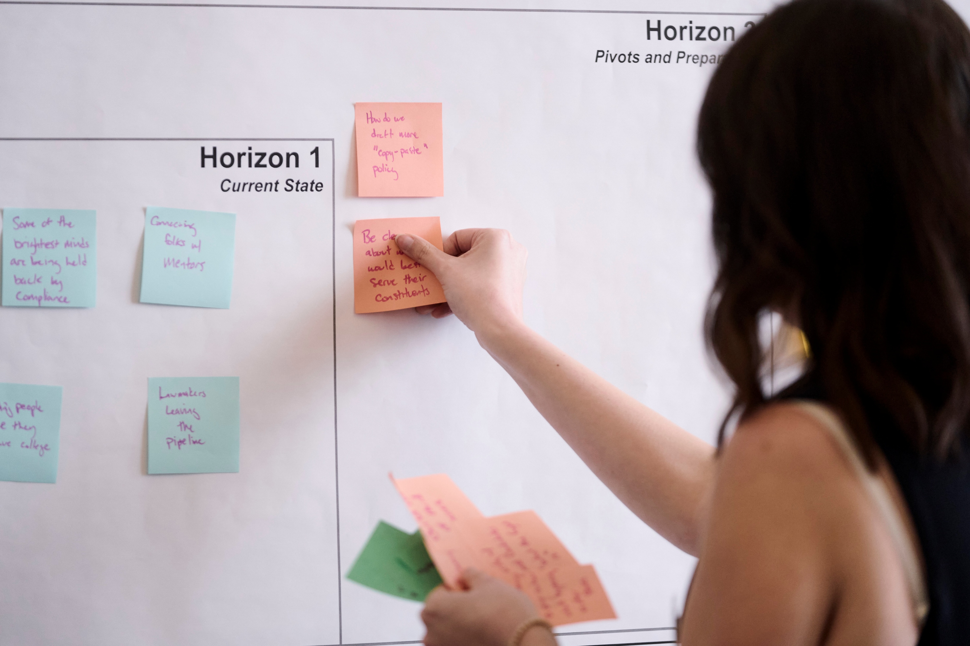
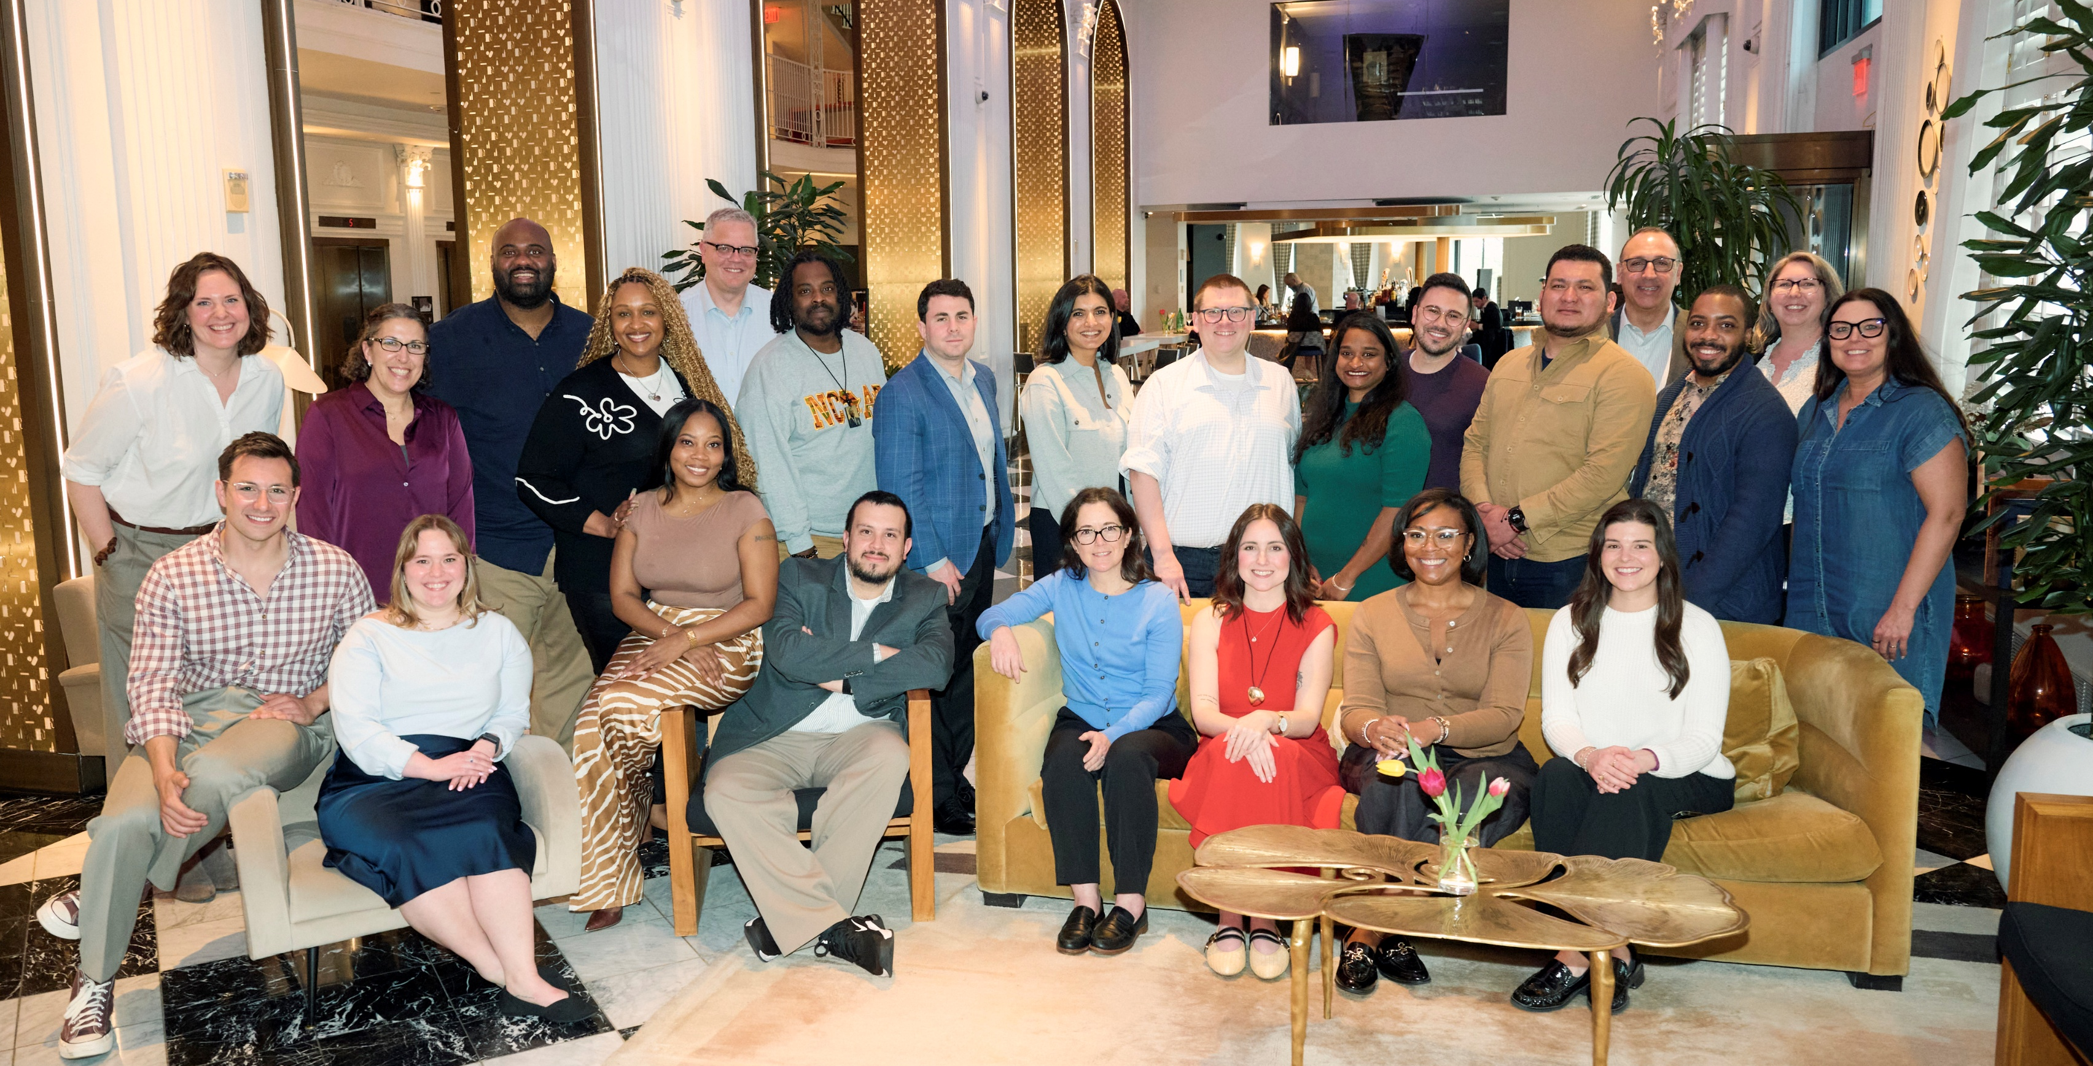
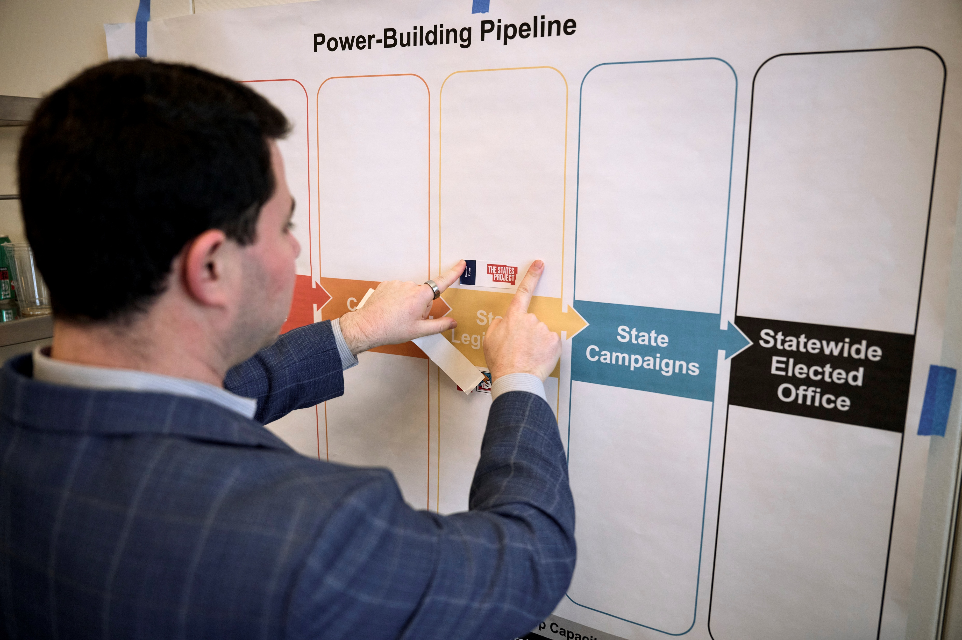
Healthy Democracy Convening
What is it?
Notes:
Annual convening of all partners in the Healthy Democracy portfolio
Dedicated time for grantees to connect, reflect, and plan for all scenarios
Opportunities to build relationships with peers from different regions
Shared learning on what’s working, what’s not, and how those insights can shape future work
Alignment, strategy, and shared learning to strengthen collective impact

Slide 26
Why We Learn with Grantees
Internally:
Deepens relationships with grantees
Strengthens understanding of work/sector
Opens opportunities for collaboration
Promotes greater alignment
Externally:
Provides peer learning across contexts
Opens connections/opportunities for collaboration
Provides space to pause and reflect
Positions for future planning
Internal learning makes greater external learning possible.

Slide 27
Creating the Conditions for Open Dialogue
What takes time:
What makes it possible:
Trust takes time
  Built over time, not in a day
Brave space needed
  Requires ongoing psychological safety
Consistent engagement
  Showing up as a trusted funder repeatedly
Guidance, not commands
  Coming alongside to help, not directing the work
  Human connection
  Opportunities for connection prior to challenging conversations
Bold conversations are the result of the long-term relationship building.

Slide 28
Same Approach, Different Emphasis
Using the “What? So What? Now What?” Model over time
Year 1 | Reflection
Year 2 | Planning
Focus: Understanding and Sensemaking
Focus: Action and Forward Planning
Emphasis on strategy, next steps, and coordination
Reflected learning applied toward collective direction
Story harvesting used to translate insights into future strategies
Emphasis on reflection and learning
Story harvesting used to surface experiences, challenges, and insights
Same structure. Different emphasis. Work that evolves over time.

Slide 29
Power of the Pause
Lessons Learned and Impact

Slide 30
Bold conversations are built over time through learning and relationship-building — not one-time gatherings.
Notes:
Discuss learning muscle building and messiness of learning together

Slide 31
Internal Impact
Increased trust and transparency
Greater willingness to navigate complexity and tensions
Less siloed work
Stronger alignment across teams and priorities
More responsive to emerging needs
Stronger connection between strategy and practice
Stronger Culture
Better Alignment
More Adaptive Work
Learning strengthens how we work together.

Slide 32
External Impact
Greater cross-organization relationships
Expands dialogue across geographies and perspectives
Facilitates meaningful peer exchanges
Increases shared learnings across organizations
Creates dedicated time to pause
Supports collective forward planning
Stronger Connections
More Peer Learning
Space to
Reflect
Learning strengthens how the field works together.

Slide 33
We’re aiming to create a virtuous cycle of aligning, acting, and learning that results in better ideas, strategies, and ways of working that increase our impact.
adrienne maree brown, Emergent Strategy, p. 175
Notes:
Coming back to this quote again: For us, the Power of the Pause and Power of the Practice has been in building the shared learning muscle that helps us work through complexity together, so we can adapt more effectively to emergent community and grantee needs.
Power of the Pause, Power of Practice

Slide 34
Questions?
Notes:
Before we wrap this session, we want to provide you time to consider what you’ll carry with you, what you might try and hear questions you’re still holding.

Slide 35
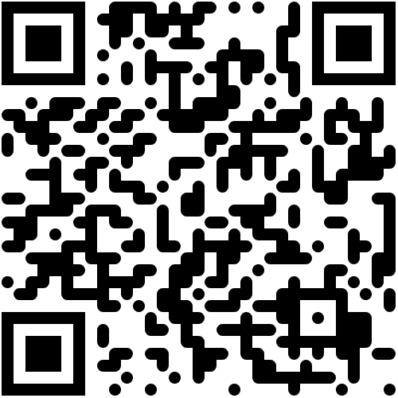
Tools and Templates

Slide 36
Get in Touch
Dr. Amy Erickson Soper
Director, Org. Learning & Impact
Amy.soper@childrensequityfund.org
Asoper@bainumfdn.org
Gabriela Fitz
Independent Consultant
Think Twice
Gabi@thinktwicellc.com
Julia McKay
Senior Manager, Healthy Democracy
Julia.mckay@childrensequityfund.org

